Slide 1

Operating Systems Unit III::Process Management Process Synchronization

Slide 2
Outline
Background
The Critical-Section Problem
Synchronization Hardware
Semaphores
Classical Problems of Synchronization
Critical Regions
Monitors
Synchronization in Solaris 2 & Windows 2000

Slide 3
1.Background
Concurrent access to shared data may result in data inconsistency.
Maintaining data consistency requires mechanisms to ensure the orderly execution of cooperating processes.
Shared-memory solution to bounded-butter problem (Chapter 4) allows at most n – 1 items in buffer at the same time. A solution, where all N buffers are used is not simple.
Suppose that we modify the producer-consumer code by adding a variable counter, initialized to 0 and incremented each time a new item is added to the buffer

Slide 4
Bounded-Buffer
Shared data
#define BUFFER_SIZE 10
typedef struct {
. . .
} item;
item buffer[BUFFER_SIZE];
int in = 0;
int out = 0;
int counter = 0;

Slide 5
Bounded-Buffer
Producer process
item nextProduced;
while (1) {
while (counter == BUFFER_SIZE)
; /* do nothing */
buffer[in] = nextProduced;
in = (in + 1) % BUFFER_SIZE;
counter++;
}

Slide 6
Bounded-Buffer
Consumer process
item nextConsumed;
while (1) {
while (counter == 0)
; /* do nothing */
nextConsumed = buffer[out];
out = (out + 1) % BUFFER_SIZE;
counter--;
}

Slide 7
Bounded Buffer
The statements counter++; counter--; must be performed atomically.
Atomic operation means an operation that completes in its entirety without interruption.

Slide 8
Bounded Buffer
The statement “count++” may be implemented in machine language as: register1 = counter
register1 = register1 + 1 counter = register1
The statement “count—” may be implemented as: register2 = counter register2 = register2 – 1 counter = register2

Slide 9
Bounded Buffer
If both the producer and consumer attempt to update the buffer concurrently, the assembly language statements may get interleaved.
Interleaving depends upon how the producer and consumer processes are scheduled.

Slide 10
Bounded Buffer
Assume counter is initially 5. One interleaving of statements is: producer: register1 = counter (register1 = 5) producer: register1 = register1 + 1 (register1 = 6) consumer: register2 = counter (register2 = 5) consumer: register2 = register2 – 1 (register2 = 4) producer: counter = register1 (counter = 6) consumer: counter = register2 (counter = 4)
The value of count may be either 4 or 6, where the correct result should be 5.

Slide 11
Race Condition
Race condition: The situation where several processes access – and manipulate shared data concurrently. The final value of the shared data depends upon which process finishes last.
To prevent race conditions, concurrent processes must be synchronized.

Slide 12
2.The Critical-Section Problem
n processes all competing to use some shared data
Each process has a code segment, called critical section, in which the shared data is accessed.
Problem – ensure that when one process is executing in its critical section, no other process is allowed to execute in its critical section.

Slide 13
Solution to Critical-Section Problem
1. Mutual Exclusion. If process P_{i} is executing in its critical section, then no other processes can be executing in their critical sections.
2. Progress. If no process is executing in its critical section and there exist some processes that wish to enter their critical section, then the selection of the processes that will enter the critical section next cannot be postponed indefinitely.
3. Bounded Waiting. A bound must exist on the number of times that other processes are allowed to enter their critical sections after a process has made a request to enter its critical section and before that request is granted.
Assume that each process executes at a nonzero speed
No assumption concerning relative speed of the n processes.

Slide 14
Initial Attempts to Solve Problem
Only 2 processes, P₀ and P₁
General structure of process P_{i} (other process P_{j})
do {
entry section
critical section
exit section
reminder section
} while (1);
Processes may share some common variables to synchronize their actions.

Slide 15
Algorithm 1
Shared variables:
int turn; initially turn = 0
turn - i ⇒ P_{i} can enter its critical section
Process P_{i}
do {
while (turn != i) ;
critical section
turn = j;
reminder section
} while (1);
Satisfies mutual exclusion, but not progress

Slide 16
Algorithm 2
Shared variables
boolean flag[2]; initially flag [0] = flag [1] = false.
flag [i] = true ⇒ P_{i} ready to enter its critical section
Process P_{i}
do {
flag[i] := true; while (flag[j]) ; critical section
flag [i] = false;
remainder section
} while (1);
Satisfies mutual exclusion, but not progress requirement.

Slide 17
Algorithm 3
Combined shared variables of algorithms 1 and 2.
Process P_{i}
do {
flag [i]:= true; turn = j; while (flag [j] and turn = j) ;
critical section
flag [i] = false;
remainder section
} while (1);
Meets all three requirements; solves the critical-section problem for two processes.

Slide 18
Bakery Algorithm
Critical section for n processes
Before entering its critical section, process receives a number. Holder of the smallest number enters the critical section.
If processes P_{i} and P_{j} receive the same number, if i < j, then P_{i} is served first; else P_{j} is served first.
The numbering scheme always generates numbers in increasing order of enumeration; i.e., 1,2,3,3,3,3,4,5...

Slide 19
Bakery Algorithm
Notation <≡ lexicographical order (ticket #, process id #)
(a,b) < c,d) if a < c or if a = c and b < d
max (a₀,…, a_{n-1}) is a number, k, such that k ≥ a_{i} for i - 0, …, n – 1
Shared data
boolean choosing[n];
int number[n];
Data structures are initialized to false and 0 respectively

Slide 20
Bakery Algorithm
do {
choosing[i] = true;
number[i] = max(number[0], number[1], …, number [n – 1])+1;
choosing[i] = false;
for (j = 0; j < n; j++) {
while (choosing[j]) ;
while ((number[j] != 0) && (number[j,j] < number[i,i])) ;
}
critical section
number[i] = 0;
remainder section
} while (1);

Slide 21
3.Synchronization Hardware
Test and modify the content of a word atomically .
boolean TestAndSet(boolean &target) {
boolean rv = target;
tqrget = true;
return rv;
}

Slide 22
Mutual Exclusion with Test-and-Set
Shared data: boolean lock = false;
Process P_{i}
do {
while (TestAndSet(lock)) ;
critical section
lock = false;
remainder section
}

Slide 23
Synchronization Hardware
Atomically swap two variables.
void Swap(boolean &a, boolean &b) {
boolean temp = a;
a = b;
b = temp;
}

Slide 24
Mutual Exclusion with Swap
Shared data (initialized to false): boolean lock;
boolean waiting[n];
Process P_{i}
do {
key = true;
while (key == true)
Swap(lock,key);
critical section
lock = false;
remainder section
}

Slide 25
4.Semaphores
Synchronization tool that does not require busy waiting.
Semaphore S – integer variable
can only be accessed via two indivisible (atomic) operations
wait (S):
while S≤ 0 do no-op; S--;
signal (S):
S++;

Slide 26
Critical Section of n Processes
Shared data:
semaphore mutex; //initially mutex = 1
Process Pi: do { wait(mutex); critical section
signal(mutex); remainder section } while (1);

Slide 27
Semaphore Implementation
Define a semaphore as a record
typedef struct {
int value; struct process *L; } semaphore;
Assume two simple operations:
block suspends the process that invokes it.
wakeup(P) resumes the execution of a blocked process P.

Slide 28
Implementation
Semaphore operations now defined as
wait(S): S.value--;
if (S.value < 0) {
add this process to S.L; block;
}
signal(S): S.value++;
if (S.value <= 0) {
remove a process P from S.L; wakeup(P);
}

Slide 29
Semaphore as a General Synchronization Tool
Execute B in P_{j} only after A executed in P_{i}
Use semaphore flag initialized to 0
Code:
P_{i} P_{j}
 
A wait(flag)
signal(flag) B

Slide 30
Deadlock and Starvation
Deadlock – two or more processes are waiting indefinitely for an event that can be caused by only one of the waiting processes.
Let S and Q be two semaphores initialized to 1
P₀ P₁
wait(S); wait(Q);
wait(Q); wait(S);
 
signal(S); signal(Q);
signal(Q) signal(S);
Starvation – indefinite blocking. A process may never be removed from the semaphore queue in which it is suspended.

Slide 31
Two Types of Semaphores
Counting semaphore – integer value can range over an unrestricted domain.
Binary semaphore – integer value can range only between 0 and 1; can be simpler to implement.
Can implement a counting semaphore S as a binary semaphore.

Slide 32
Implementing S as a Binary Semaphore
Data structures:
binary-semaphore S1, S2;
int C:
Initialization:
S1 = 1
S2 = 0
C = initial value of semaphore S

Slide 33
Implementing S
wait operation
wait(S1);
C--;
if (C < 0) {
signal(S1);
wait(S2);
}
signal(S1);
signal operation
wait(S1);
C ++;
if (C <= 0)
signal(S2);
else
signal(S1);

Slide 34
5.Classical Problems of Synchronization
Bounded-Buffer Problem
Readers and Writers Problem
Dining-Philosophers Problem

Slide 35
Bounded-Buffer Problem
Shared data semaphore full, empty, mutex; Initially: full = 0, empty = n, mutex = 1

Slide 36
Bounded-Buffer Problem Producer Process
do {
…
produce an item in nextp
…
wait(empty);
wait(mutex);
…
add nextp to buffer
…
signal(mutex);
signal(full);
} while (1);

Slide 37
Bounded-Buffer Problem Consumer Process
do {
wait(full)
wait(mutex);
…
remove an item from buffer to nextc
…
signal(mutex);
signal(empty);
…
consume the item in nextc
…
} while (1);

Slide 38
Readers-Writers Problem
Shared data semaphore mutex, wrt; Initially mutex = 1, wrt = 1, readcount = 0

Slide 39
Readers-Writers Problem Writer Process
wait(wrt);
…
writing is performed
…
signal(wrt);

Slide 40
Readers-Writers Problem Reader Process
wait(mutex);
readcount++;
if (readcount == 1)
wait(rt);
signal(mutex);
…
reading is performed
…
wait(mutex);
readcount--;
if (readcount == 0)
signal(wrt);
signal(mutex):

Slide 41
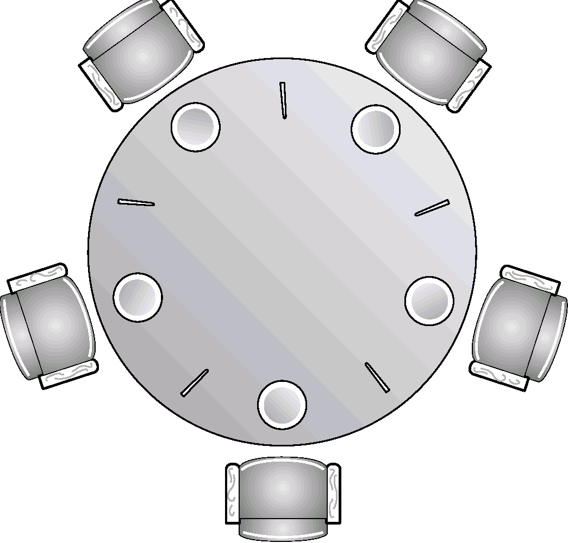
Dining-Philosophers Problem
Shared data
semaphore chopstick[5];
Initially all values are 1

Slide 42
Dining-Philosophers Problem
Philosopher i:
do {
wait(chopstick[i])
wait(chopstick[(i+1) % 5])
…
eat
…
signal(chopstick[i]);
signal(chopstick[(i+1) % 5]);
…
think
…
} while (1);

Slide 43
6.Critical Regions
High-level synchronization construct
A shared variable v of type T, is declared as:
v: shared T
Variable v accessed only inside statement
region v when B do S where B is a boolean expression.
While statement S is being executed, no other process can access variable v.

Slide 44
Critical Regions
Regions referring to the same shared variable exclude each other in time.
When a process tries to execute the region statement, the Boolean expression B is evaluated. If B is true, statement S is executed. If it is false, the process is delayed until B becomes true and no other process is in the region associated with v.

Slide 45
Example – Bounded Buffer
Shared data:
struct buffer {
int pool[n];
int count, in, out;
}

Slide 46
Bounded Buffer Producer Process
Producer process inserts nextp into the shared buffer
region buffer when( count < n) { pool[in] = nextp; in:= (in+1) % n; count++; }

Slide 47
Bounded Buffer Consumer Process
Consumer process removes an item from the shared buffer and puts it in nextc
region buffer when (count > 0) { nextc = pool[out]; out = (out+1) % n; count--; }

Slide 48
Implementation region x when B do S
Associate with the shared variable x, the following variables:
semaphore mutex, first-delay, second-delay; int first-count, second-count;
Mutually exclusive access to the critical section is provided by mutex.
If a process cannot enter the critical section because the Boolean expression B is false, it initially waits on the first-delay semaphore; moved to the second-delay semaphore before it is allowed to reevaluate B.

Slide 49
Implementation
Keep track of the number of processes waiting on first-delay and second-delay, with first-count and second-count respectively.
The algorithm assumes a FIFO ordering in the queuing of processes for a semaphore.
For an arbitrary queuing discipline, a more complicated implementation is required.

Slide 50
7.Monitors
High-level synchronization construct that allows the safe sharing of an abstract data type among concurrent processes.
monitor monitor-name
{
shared variable declarations
procedure body P1 (…) {
. . .
}
procedure body P2 (…) {
. . .
}
procedure body Pn (…) {
. . .
}
{
initialization code
}
}

Slide 51
Monitors
To allow a process to wait within the monitor, a condition variable must be declared, as
condition x, y;
Condition variable can only be used with the operations wait and signal.
The operation
x.wait(); means that the process invoking this operation is suspended until another process invokes
x.signal();
The x.signal operation resumes exactly one suspended process. If no process is suspended, then the signal operation has no effect.

Slide 52
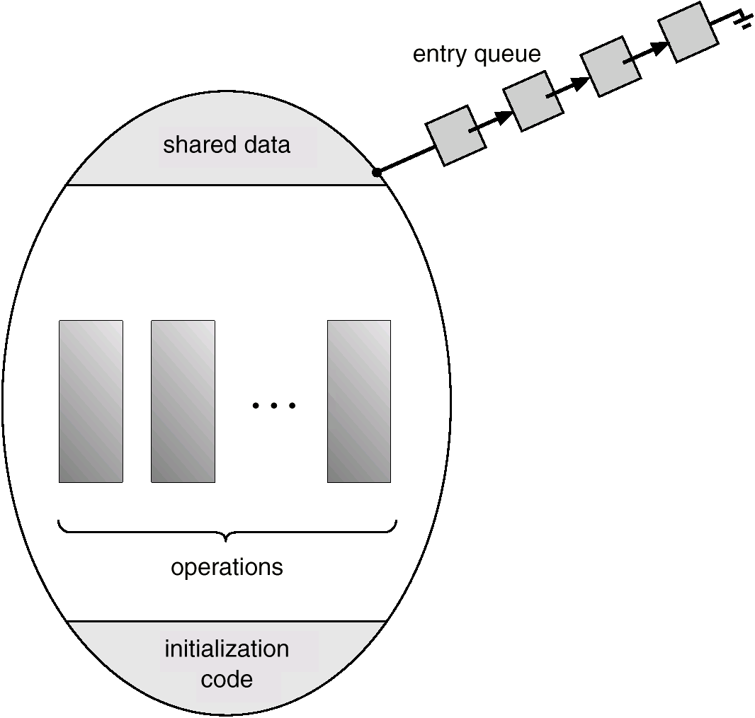
Schematic View of a Monitor

Slide 53
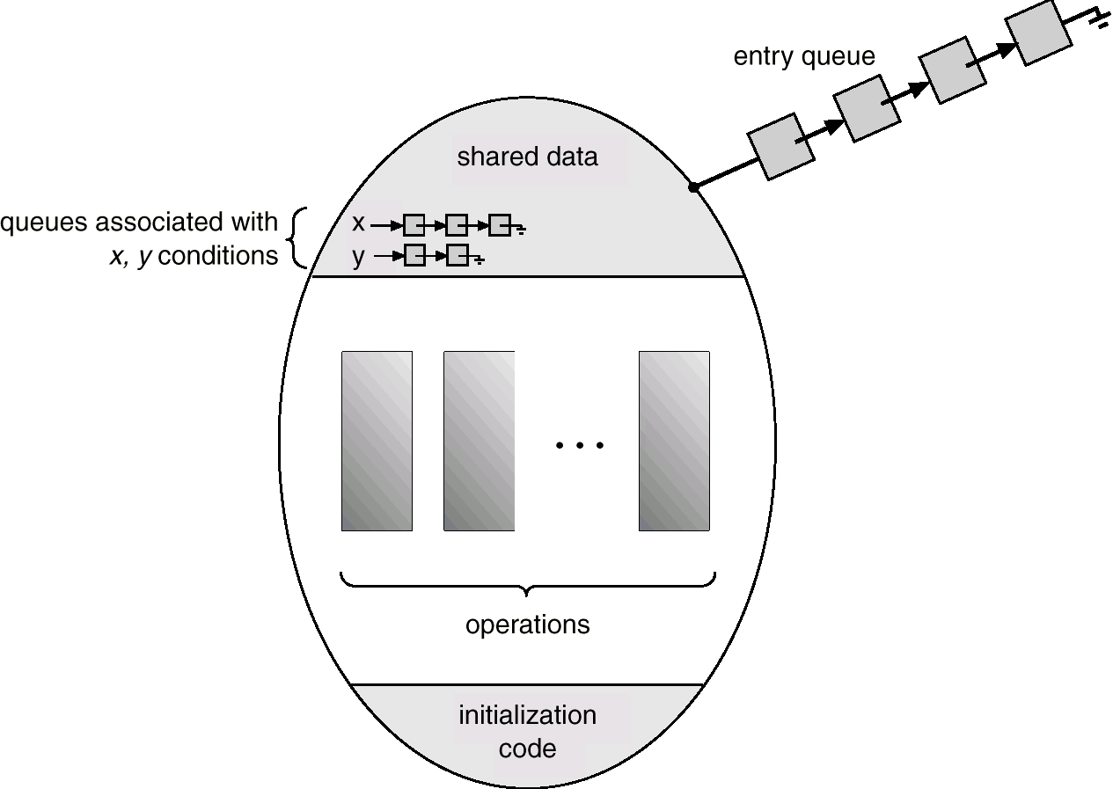
Monitor With Condition Variables

Slide 54
Dining Philosophers Example
monitor dp
{
enum {thinking, hungry, eating} state[5];
condition self[5];
void pickup(int i) // following slides
void putdown(int i) // following slides
void test(int i) // following slides
void init() {
for (int i = 0; i < 5; i++)
state[i] = thinking;
}
}

Slide 55
Dining Philosophers
void pickup(int i) {
state[i] = hungry;
test[i];
if (state[i] != eating)
self[i].wait();
}
void putdown(int i) {
state[i] = thinking;
// test left and right neighbors
test((i+4) % 5);
test((i+1) % 5);
}

Slide 56
Dining Philosophers
void test(int i) {
if ( (state[(I + 4) % 5] != eating) &&
(state[i] == hungry) &&
(state[(i + 1) % 5] != eating)) {
state[i] = eating;
self[i].signal();
}
}

Slide 57
Monitor Implementation Using Semaphores
Variables
semaphore mutex; // (initially = 1)
semaphore next; // (initially = 0)
int next-count = 0;
Each external procedure F will be replaced by
wait(mutex);
…
body of F;
…
if (next-count > 0)
signal(next)
else
signal(mutex);
Mutual exclusion within a monitor is ensured.

Slide 58
Monitor Implementation
For each condition variable x, we have:
semaphore x-sem; // (initially = 0)
int x-count = 0;
The operation x.wait can be implemented as:
x-count++;
if (next-count > 0)
signal(next);
else
signal(mutex);
wait(x-sem);
x-count--;

Slide 59
Monitor Implementation
The operation x.signal can be implemented as:
if (x-count > 0) {
next-count++;
signal(x-sem);
wait(next);
next-count--;
}

Slide 60
Monitor Implementation
Conditional-wait construct: x.wait(c);
c – integer expression evaluated when the wait operation is executed.
value of c (a priority number) stored with the name of the process that is suspended.
when x.signal is executed, process with smallest associated priority number is resumed next.
Check two conditions to establish correctness of system:
User processes must always make their calls on the monitor in a correct sequence.
Must ensure that an uncooperative process does not ignore the mutual-exclusion gateway provided by the monitor, and try to access the shared resource directly, without using the access protocols.

Slide 61
8.Solaris 2 Synchronization
Implements a variety of locks to support multitasking, multithreading (including real-time threads), and multiprocessing.
Uses adaptive mutexes for efficiency when protecting data from short code segments.
Uses condition variables and readers-writers locks when longer sections of code need access to data.
Uses turnstiles to order the list of threads waiting to acquire either an adaptive mutex or reader-writer lock.

Slide 62
Windows 2000 Synchronization
Uses interrupt masks to protect access to global resources on uniprocessor systems.
Uses spinlocks on multiprocessor systems.
Also provides dispatcher objects which may act as wither mutexes and semaphores.
Dispatcher objects may also provide events. An event acts much like a condition variable.

Slide 63
Text Books & References :
Abraham Silberchatz, Peter B. Galvin, Greg Gagne, Operating System Concepts, 9th edition, John Wiley.
Stallings, Operating Systems-Internal and Design Principles, 6th edition, Pearson education.
D.M.Dhamdhere, Operating systems- A Concept based Approach, 2ndedition, TMH.
Crowley, Operating System A Design Approach, 1st edition, TMH.
Andrew S Tanenbaum, Modern Operating Systems, 3rd edition, PHI.
Gary J. Nutt, Operating Systems: A Modern Perspective, 2nd Edition, Addison-Wesley.
http://nptel.iitm.ac.in/courses/Webcourse-contents/IISc-BANG/Operating%20Systems/New_index1.html

Slide 64
Thank You

